Slide 1

Emotion Detection From Text by using Basic to Advanced NLP Techniques
Done by:
Team A3:
B. Deekshitha Reddy – 18R11A05F1
Akshita Yerram – 18R11A05E5
Jyoti Gouda – 18R11A05G5

Slide 2


ABSTRACT
Emotion recognition from text is crucial Natural Language Processing task which can contribute enormous benefits to different areas such as artificial intelligence, human interaction with computers etc. Emotions are physiologic thoughts engendered in human reactions to the events. Analysis of these emotions without facial and voice modulation are critical and requires a supervisory approach for proper interpretation of emotions. In spite of these challenges, it's essential to acknowledge the human emotions as they progressively communicate using mistreatment text through social media applications such as Facebook, Twitter etc. In this project, we propose a sentimental classification of multitude of texts. Here, we use NLP advanced techniques to classify the sentiments of an expression into anger, disgust, fear, guilt, joy, sadness and shame etc.

Slide 3
RequireMents
Python
Dataset
Numpy
Seaborn
Pandas
Matplotlib

Slide 4


Requirements contd….
Operating Systems
Hardware Requirements
Windows 10
Windows 8, 8.1
Windows 7
Windows vista
Windows server 2008 and later
Linux
Unix
Mac
Processor: i3 processor (Minimum)
RAM : 4 GB (minimum), 8 GB (recommended)
Hard disc: up to 1 TB of free space may be required

Slide 5

Requirements contd….
Web browsers
Internet Explorer | Microsoft Edge | Mozilla Firefox | Chrome | Opera | Safari
8 + | Latest | Latest | 22 + | 17 + | 12 + | 5 +
Datasets from “Kaggle open source”.
Jupyter Notebook.
Anaconda and google colab etc…

Slide 6
EXISTING SYSTEM
Before the emotion detection using text the emotions associated with various contexts were not being differentiated.
The social media Platforms couldn’t able detect the emotion using text automatically and summarize the need of the various scenarios.

Slide 7
PROPOSED SYSTEM :
Using BERT MODEL (Bidirectional Encoder Representations from Transformers), the goal is to classify each emotion in text into anger, disgust, fear, guilt, joy, sadness and shame etc.
LSTM (Longest Short-term Memory) i.e artificial recurrent neural network (RNN) architecture used in the field of deep learning to understand the context of the emotion and classify it accordingly.
The Machine Learning model can automatically detect the input text and categorize according to the text emotion whose summary is useful for various purposes.

Slide 8
LITERATURE SURVEY
https://ieeexplore.ieee.org/document/9388382/references#references
"Twitter sentiment analysis using machine learning for product evaluation", 2020 International Conference on Inventive Computation Technologies (ICICT), pp. 181-185, 2020.
"Lstm-based text emotion recognition using semantic and emotional word vectors", 2018 First Asian Conference on Affective Computing and Intelligent Interaction (ACII Asia), pp. 1-6, 2018.

Slide 9
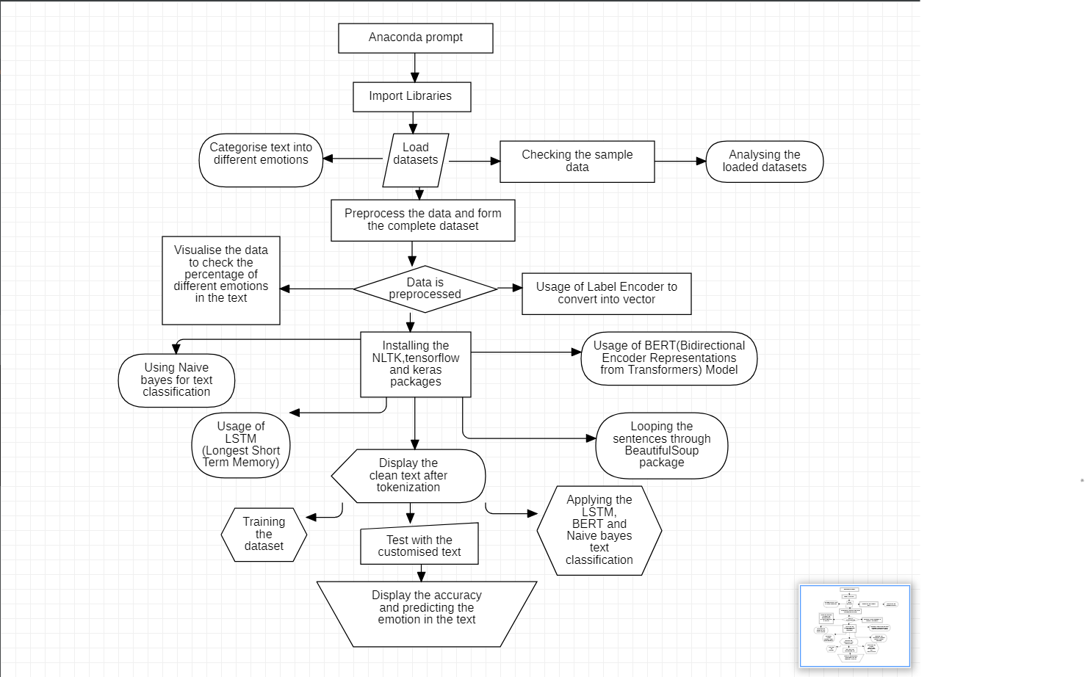
Block Diagram of Design

Slide 10
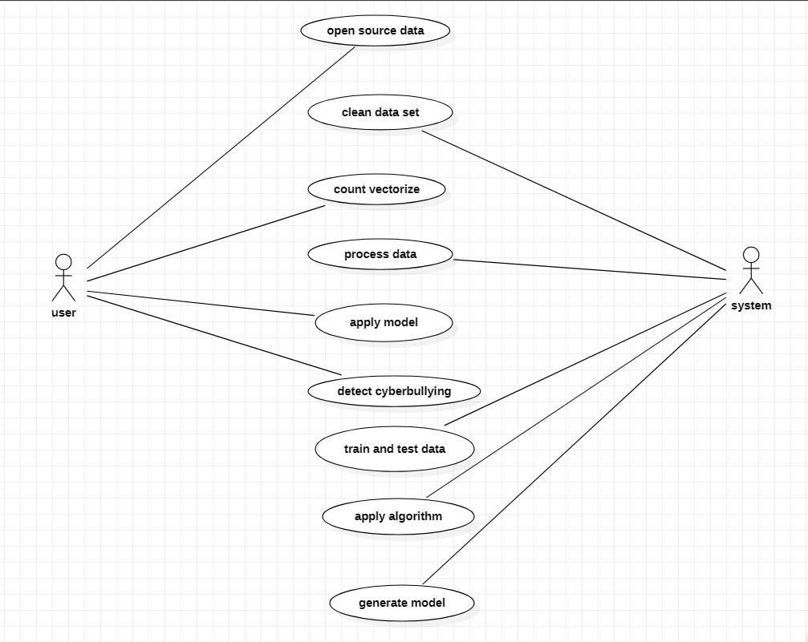
Use case diagram

Slide 11
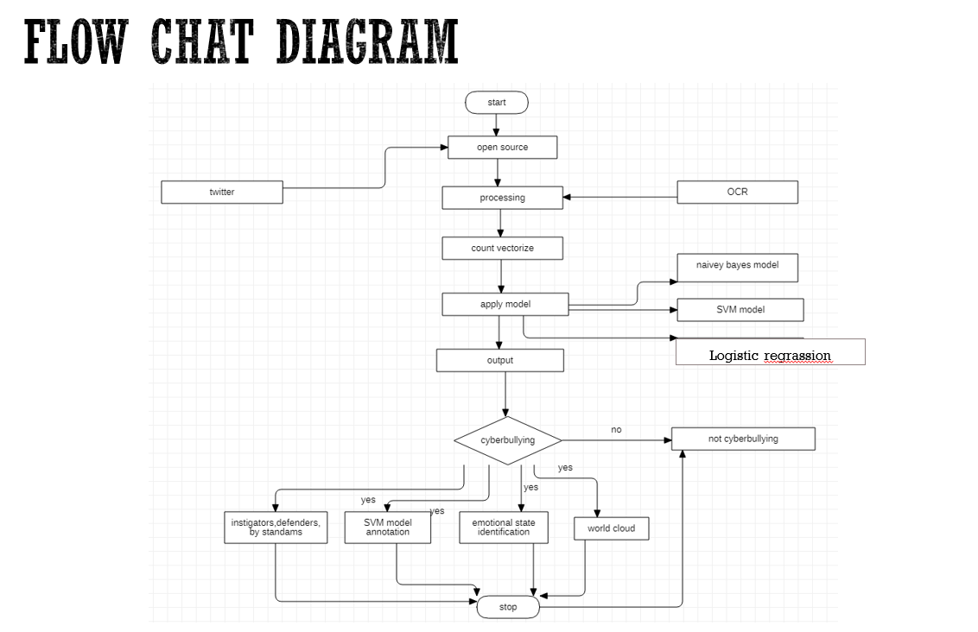

Slide 12
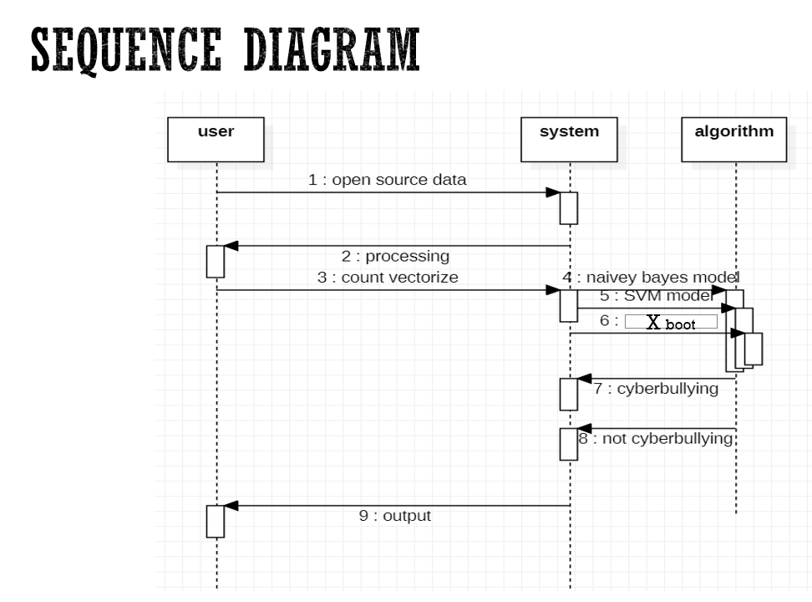

Slide 13
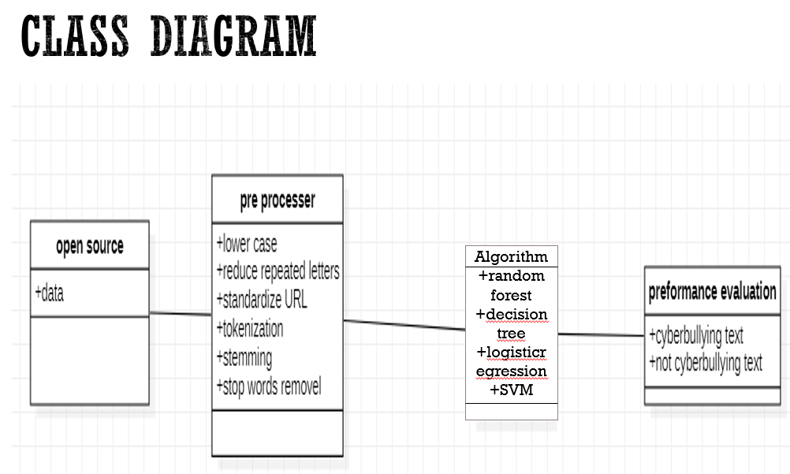

Slide 14

Thank you
Thank you.

